Slide 1


SWISSBOT
Autonomous bot platform based on deep reinforcement learning for
Team Fortress 2 (2007)

Slide 2
Group Members & Project Advisor
Group Members:
Tristan McGinnis – Computer Science – mcginntw@mail.uc.edu
Project Advisor:
Dr. Fred Annexstein – fred.annexstein@uc.edu

Slide 3
Project Abstract
SWISSBOT is a fully autonomous process that utilizes Deep RL’s machine-learning library to control and teach a computer-controlled player (bot) how to navigate, prioritize tasks, and succeed in both objective and combat based gameplay against enemy players. Using a deep reinforcement method of machine-learning, the bots will be trained on thousands of attempts for arbitrary gameplay rewards that will eventually concatenate to emulate the skills of a human player. SWISSBOT is to be used to analyze optimal gameplay decisions and to provide a fun challenge for human players to fight.

Slide 4
User Stories
As a player, I want to play against a challenging and life-like opponent so I can improve my skills.
As a server administrator, I want to provide my players with a challenging alternative to the standard gameplay loop, so my players have fun and server retention increases.
As a game theorist, I want to analyze the optimal way to play and navigate this game so I can implement common player decision-making into my own projects.

Slide 5
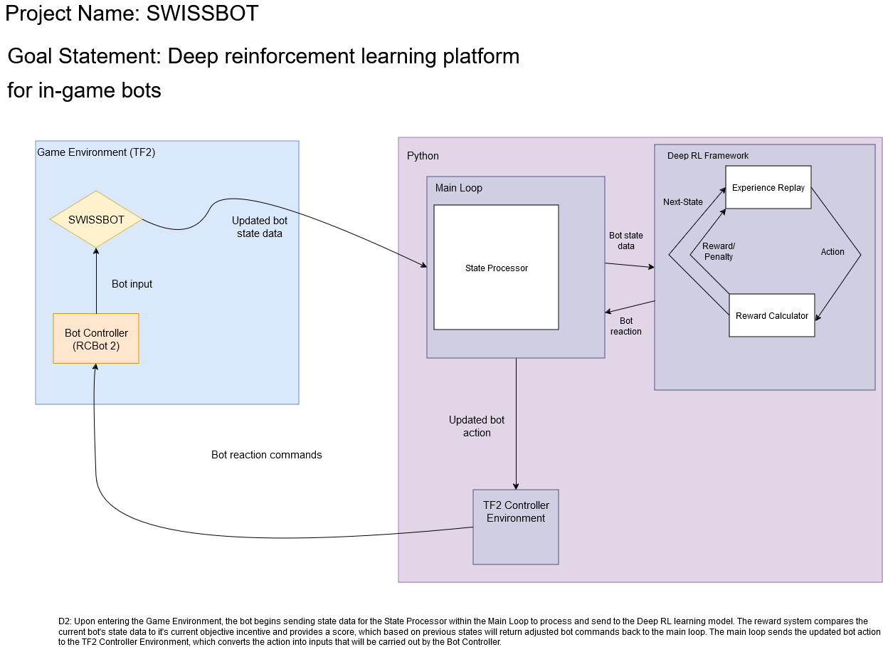
Design Diagrams

Slide 6
Major Project Constraints
Ethical
Previously this very game was plagued with a malicious attack utilizing similar autonomous bots
By definition, a machine that automatically aims and wins for a player is considered cheating
Security
Should my code be released to the public, further malicious acts could incur.
Social
Releasing a machine that was programmed to emulate or succeed human skill into public servers would not make for a fun environment in an entertainment medium.

Slide 7
Review of Project Progress
Research of the following software and languages:
SourceMod
SourcePawn
Deep RL library
RCBot 2
Valve Developer SDK

Slide 8
Expected Accomplishments
Research of the following software and languages:
SourceMod
SourcePawn
Deep RL library
RCBot 2
Valve Developer SDK

Slide 9

Division of Work
Research, Development, Testing, Documentation, Presentation:
Tristan McGinnis – 100%

Slide 10
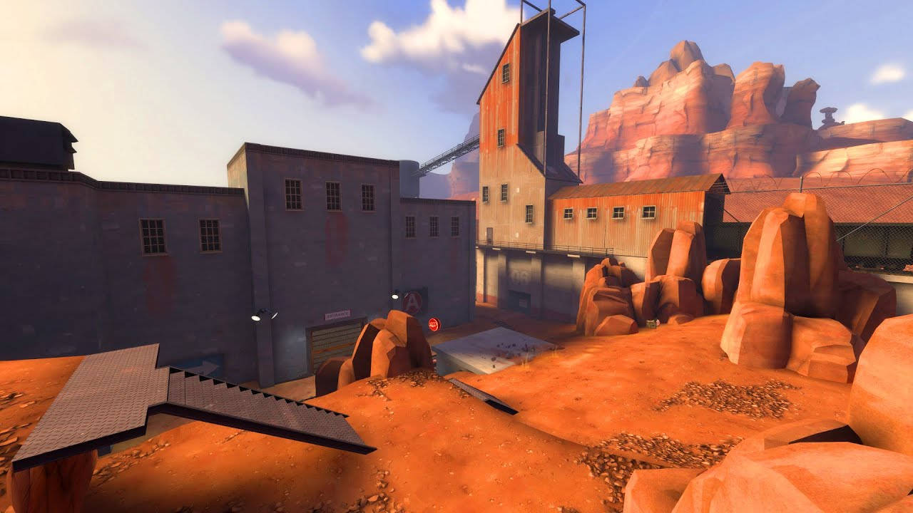
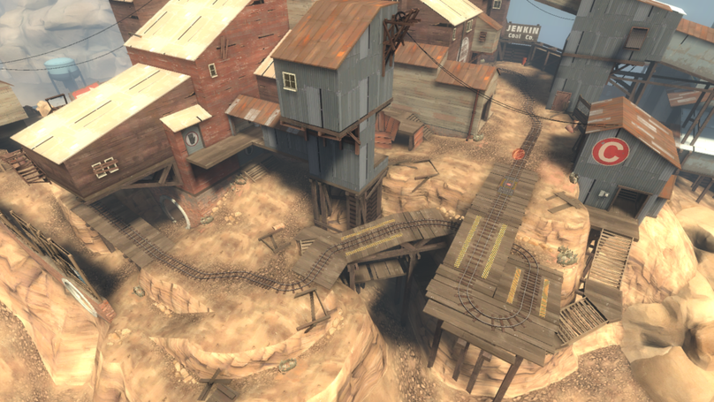
Expected Demo at Expo
Demo:
Machine hosting an offline KOTH (King of the Hill) game of Team Fortress 2
SWISSBOT team (12) vs. BLU team (12), utilizing the game’s SPECTATOR mode to observe gameplay from each bot.
Demo of the team of bots completing games on varying gamemodes.
Training data and screenshots of testing stages and incremental progress.

